Slide 1

教学辅助课件
牛津 七年级下

Slide 2

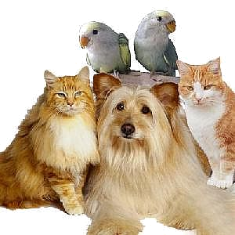

Unit 8 Pets
Grammar

Slide 3


Words & phrase review
anywhere
repeat
all the time
agree
keep
adv. 任何地方
vt. & vi. 重复
一直，总是
vi. & vt. 同意；应允
vt. 养，饲养
Read after the tape and speak out the Chinese immediately.

Slide 4
Objectives
(1)To be able to use adjectives
(2)To be able to use indefinite pronouns
(3)To learn the new words and useful expressions: anywhere, repeat, agree, keep get tired, sleep anywhere, all the time repeat my words, come back home Goldfish are easy to look after.

Slide 5
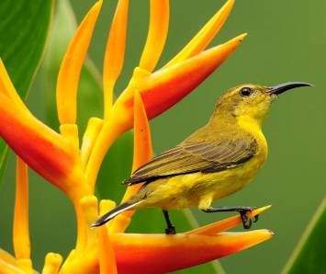
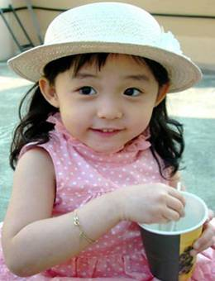
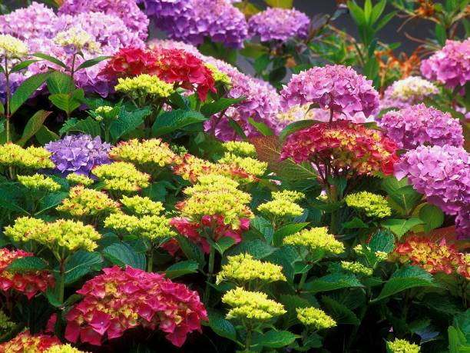
We use adjectives to describe people or things.
adjectives 形容词
What a beautiful bird it is!
The flowers are colorful.
thing
She is a pretty girl.
people
Now let’s read more examples.

Slide 6



1. She is tall and slim. (七年级上册 U1)
2. Li Hua is my favourite football star. (七上 U2)
3. The classrooms are clean and bright. (七上 U3)
4. We always have a good time at school. (七上U4)
5. It is wonderful. (七上U5)
6. Sometimes, I feel hungry between meals, so I
eat an apple or a pear. (七上 U6)
7. Yes, they’re very pretty. (七上 U7)
8. He looks smart. (七上 U8)
9. They are kind and helpful. (七下 U2)
10. The air is fresh here. (七下 U3)

Slide 7
Sentences from this unit:
1. I want a new pet!
2. How rude you are!
3. … it’s very small and soft …
4. I like her long ears.
5. My goldfish is a wonderful pet.
6. She doesn’t need a gentle touch.

Slide 8

1. She is ____ and ____.
2. Li Hua is my __________ football star.
3. The classrooms are _____ and ______.
4. We always have a _____ time at school.
5. It is __________.
6. Sometimes, I feel ______ between
meals, so I eat an apple or a pear.
7. Yes, they’re very ______.
8. He looks ______.
9. They are _____ and _______.
10. The air is ______ here.
tall
slim
favourite
clean
bright
Ready?
good
go
wonderful
hungry
pretty
smart
kind
helpful
fresh

Slide 9

11. I want a ____ pet!
12. How _____ you are!
13. … it’s very _____ and ____ …
14. I like her _____ ears.
15. My goldfish is a _________ pet.
16. She doesn’t need a _____ touch.
new
rude
small
soft
long
wonderful
gentle

Slide 10
k
直击中考
1. The show was so_____ that I couldn’t stop laughing. (2018重庆市)
A. sad B. terrible C. funny D. serious
2. We experienced a few ___ moments as we waited to hear the results of the test. (2018武汉) .
A. pleasant B. anxious
C. hopeful D. disappointing
Notes:
“碰壁点拨式”教学法是素质教育的一种方式，这种教学法的基本模式是：编拟题组—练中碰壁—讲评点拨—巩固消化。该教学法以问题为载体，以训练为主线，目标导控，问题教学，先练后讲，碰壁点拨，反馈矫正。增强了学习的方向性、选择性及目标性，使学生在克服困难消除障碍的过程中发展自己的观察力、想象力和思维能力，使他们的智慧升华，创造思维得以开发。

Slide 11

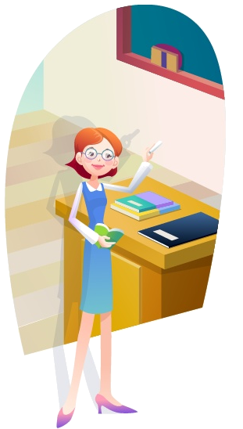
Focus on
基本含义和用法
形容词
我们用形容词来描述人或物。形容词一般放在名词的前面或者系动词的后面。

Slide 12
什么叫形容词？
形容词是修饰名词或代词，表示人或事物的性质、状态和特征的一类词。
(e.g. long, old, close, heavy, empty, cheap, hungry, etc )，在句中作定语、表语成分。

Slide 13
形容词的用法
① 形容词放在名词前作定语。
(1)今天是个阳光灿烂的日子。
It’s a sunny day today.
(2)她是一个漂亮的女孩。
She is a beautiful girl.
(3)这是一间老宅子。
This is an old house.
形容词
名词

Slide 14
②形容词放在系动词后作表语。
表状态
am, is, are
系动词
feel，look，smell，taste，sound
感官动词
表变化
go(变；成为)，become(成为，变得)，get(变得)，grow(渐渐变得)，turn(变成)等

Slide 15
(1)他很聪明。
He is very clever.
(2)教室很明亮。
The classroom is very bright.
(3)他今天看起来很高兴。
He looks very happy today.
(4) 他冻得脸色发青。
He went blue with cold.
形容词
系动词

Slide 16
Tips
① 形容词修饰名词或代词时，一般放在所修饰词的前面。
blue sky 蓝天； a big house 一所大房子
There are two chairs in the room. I want the small one.
② 形容词修饰something, anything,
nothing等复合不定代词时，要放在这些词的后面。
He wants to find something interesting to read.

Slide 17
Daniel is making some notes about pets. Help him make sentences with the words below. (P 97)
A1
make/Birds/sounds/nice
are/clever/Dogs/and/friendly
and/quite/Goldfish/look after/to/are/easy
Birds make nice sounds.
Dogs are clever and friendly.
Goldfish are quiet and easy to look after.

Slide 18

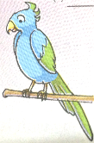
A2
Daniel found two passages about pets on the website. Complete the sentences with the words in the box. (P 97)
black clever happy hungry special tired
I have a _____ cat. She likes to run
after balls. When she gets _____, she
sleeps anywhere. She miaows when she is
_______.
My parrot is a ______ friend of mine. He is very _____, and he can repeat my words. He says “Hello!” when I come back home. He is ______ all the time.
black
tired
hungry
special
clever
happy

Slide 19

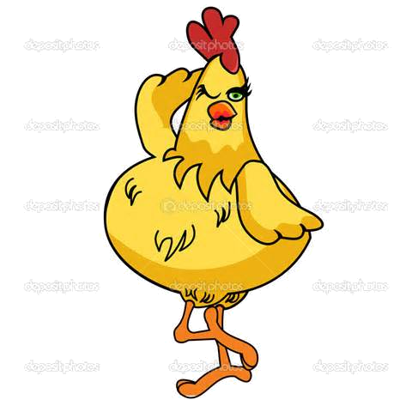

The pig took a vacation last weekend. He went to the beach, and bought something for his father. He thought everything tasted really good. He loved his vacation.
类似的词：
everyone
复合不定代词
someone
anyone
no one
...
复合不定代词指代不特定的人或物。
Now let’s read more examples.
The small hen took a vacation last weekend. She went to a mountain. She bought nothing for her father. She seemed to be bored.

Slide 20
1. Hello, everyone! (七年级上册 U1)
2. I can tell something about Millie and
her classmates. (七年级上册 U1)
3. … she’s going to ask someone to fix it.
(七年级下册 U2)
4. Can you find anyone to help you with
your homework? (七年级下册 U2)
5. There’s something wrong with my
computer. (七年级下册 U2)

Slide 21
6. Is there anything wrong with your
fridge? (七年级下册 U2)
7. Hi, everybody! (七年级下册 U4)
8. They turned around but saw nothing.
“Is anybody there?” Millie asked.
Nobody replied. (七年级下册 U5)
9. Then she told Andy everything.
(七年级下册 U5)
Sentences from this unit:
Please bring me something to eat.

Slide 22
1. Hello, e________!
2. I can tell s_________ about Millie and
her classmates.
3. … she’s going to ask s________ to fix it.
4. Can you find a______ to help you with
your homework?
5. There’s s_________ wrong with my
computer.
veryone
omething
Ready?
go
omeone
nyone
omething

Slide 23
nything
6. Is there a_______ wrong with your
fridge?
7. Hi, e_________!
8. They turned around but saw n______.
“Is a_______ there?” Millie asked.
N______ replied.
9. Then she told Andy e_________.
10. Please bring me s_________ to eat.
verybody
othing
nybody
obody
verything
omething

Slide 24
k
直击中考
1. Tom! You’re no longer a 3-year-old kid. I can cook dinner for you, but don’t expect(期待) me to do_________ for you.
Go and tidy your room! (2017江苏无锡) )
everything B. something
C. anything D. nothing
2. －How is Lily in the new school?
－She is doing very well. There is ______ to worry about. (2018福建省泉州市)
nothing B. something
C. anything D. everything
Notes:
“碰壁点拨式”教学法是素质教育的一种方式，这种教学法的基本模式是：编拟题组—练中碰壁—讲评点拨—巩固消化。该教学法以问题为载体，以训练为主线，目标导控，问题教学，先练后讲，碰壁点拨，反馈矫正。增强了学习的方向性、选择性及目标性，使学生在克服困难消除障碍的过程中发展自己的观察力、想象力和思维能力，使他们的智慧升华，创造思维得以开发。

Slide 25


不定代词
指人
指物
 | body | one | thing
some | somebody | someone | something
any | anybody | anyone | anything
no | nobody | no one | nothing
every | everybody | everyone | everything
某个
=
任何
=
没有
=
Things to remember
not anybody= nobody
not anyone=no one
not anything=nothing
=
每个
There is not anybody in the room.
=There is nobody in the room.

Slide 26
复合不定代词的用法
1. 由some-组成的复合不定代词常用于肯定句，在疑问句中，若希望得到对方的肯定回答，也会用由some-组成的复合不定代词。
1) 听！有人在敲门。
Listen! Someone is knocking at the door.
2) 你想吃点什么吗？
Would you like something to eat?

Slide 27
2. 由any-组成的复合不定代词常用于否定句或疑问句中。当由any- 组成的复合不定代词用在肯定句中时，则强调“任何人”或“任何事”。
1) 室内没有人。
There isn’t anyone/anybody in the room.
2) 任何人都应该努力工作。
Anyone should work hard.

Slide 28
3. 由no-组成的复合不定代词用于肯定句中，但表示否定的含义。
我发现教室里空无一人。
I found nobody in the classroom.
4. 复合不定代词作主语时，谓语动词通常用单数形式。
一切准备就绪。我们开始开会吧！
Everything is ready. Let’s begin our
meeting.

Slide 29
Mr Wu: Millie, I know you have a dog. What do you feed
him?
Millie: We usually give him dog food.
Mr Wu: Do you feed him ________ else?
Millie: Yes. Sometimes we give him some meat. He likes it.
Mr Wu: I see. Does _______________ have a cat?
anything
Mr Wu is asking the students about their pets. Complete their conversation with the correct indefinite pronouns. (P 98)
A1
anybody/anyone
Amy: Yes, I have a cat. She’s nice to __________________.
Mr Wu: Good. I know___________________ has goldfish,
right?
Peter: Yes, I do. Goldfish are easy to look after.
Mr Wu: That’s true. Does ______________ have a snake?
Kitty: No. ________________ wants a snake, I think.
Daniel: I don’t agree. There’s _______ wrong with keeping
a snake if you like it.
everyone/everybody
somebody/someone
anybody/anyone
Nobody/No one
nothing

Slide 30

从方框中选择适当的复合不定代词填空。
something, nobody, anything, anybody, someone
anything
1. What’s on TV tonight? Is there ________ interesting?
2. I saw ________ at the corner, but I couldn’t see him clearly.
3. Kitty is sitting alone. She isn’t with _______.
4. — Can I have _________ to drink, please?
— Sure.
5. These questions are too difficult. I think _______ can answer them.
someone
anybody
something
nobody

Slide 31




Slide 32
I. 根据汉语意思，完成英语句子。
1. 今天，天气多云，有点冷。
It’s ________ and a little ________ today.
2. 她说我就像是一个很亲近的亲戚。
She said that I was like a _______ relative.
3. 夏天，这儿既不热也不干燥。
It’s not _______ or _______ here in summer.
4. 风很大，你需要穿件暖和的外套。
The wind is _______. You need wear a _______ coat.
cloudy
cold
close
hot
dry
strong
warm

Slide 33

II. 翻译下列句子。
1. 最近每个人都很忙。
Everyone is very busy these days.
2. 傍晚没有什么事可做，只好看书。
There was nothing to do in the evening but read.
3. 我给我父母买了一些礼物，却没给自己买。
I bought some gifts for my parents, but nothing for myself.

Slide 34


Homework
Review the grammar we’ve learned today.
Finish the exercises in Learning English.
3. Preview Integrated skills on pages 99-100.

